Slide 1
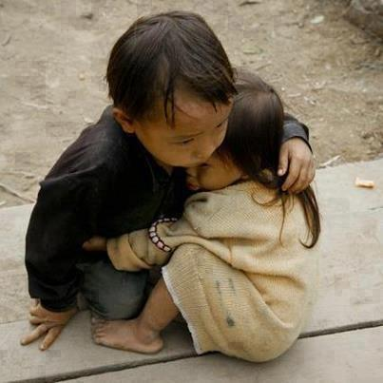
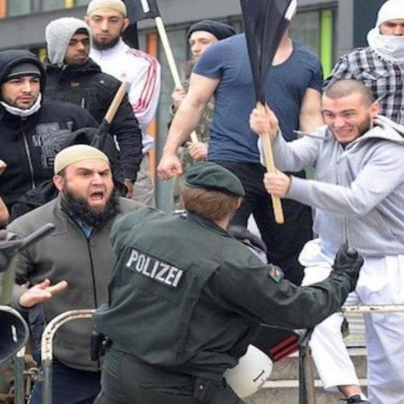
Brother protects sister in Nepal. Children are most vulnerable after #NepalEarthquake join reach to them
Muslims attack university in Kenya 15 dead, hostages taken #garissaattack.

